Slide 1
UNIT 5---Construction of trees
Construct a tree for the given Inorder and Preorder traversals
Construct a tree for the given Inorder and Postorder traversals
Construct a tree for the given Preorder and Postorder traversals

Slide 2
Construct a tree for the given Inorder and Preorder traversals
Input: Inorder and preorder travel of a binary tree
Output::::Binary tree
Algorithm:
Step 1: the first element in the preorder is the root.
Step 2: Locate the index of the root node in the inorder traversal. All the nodes before the root node in the inorder traversal forms the left subtree. All the nodes after the root node in the inorder traversal forms the right subtree.
Step 3: Now perform the steps 1 and 2 until the tree is constructed.

Slide 3
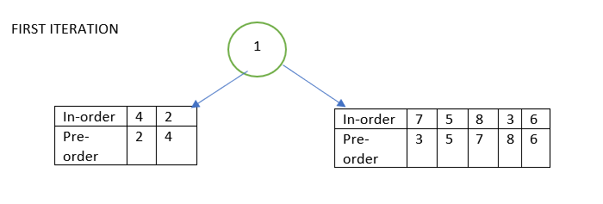
Example
In-order | 4 | 2 | 1 | 7 | 5 | 8 | 3 | 6
Pre-order | 1 | 2 | 4 | 3 | 5 | 7 | 8 | 6

Slide 4
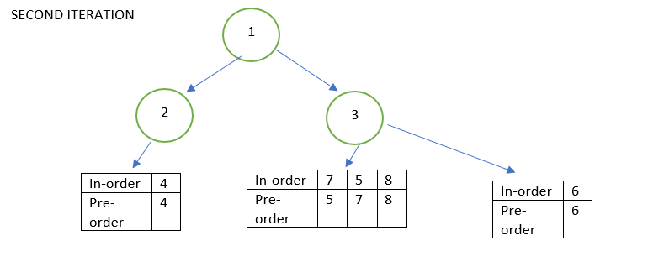

Slide 5
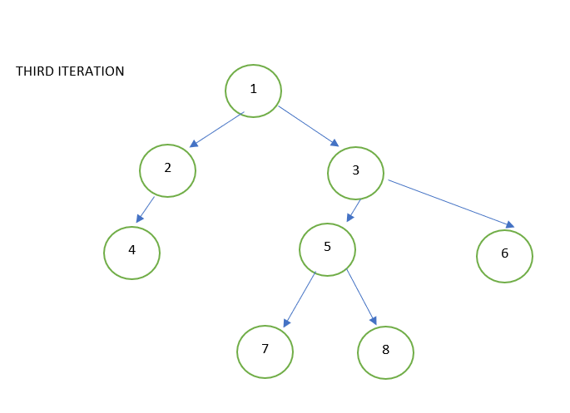

Slide 6
Try it yourself!!!!!!!
Construct a tree for the given Inorder and Preorder traversals
Preorder : G B Q A C K F P D E R H
Inorder: Q B K C F A G P E D H R
Construct a Binary tree from a given Preorder and inorder sequence :
Preorder: A B D G C E H I F
Inorder: D G B A H E I C F

Slide 7
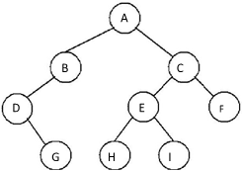
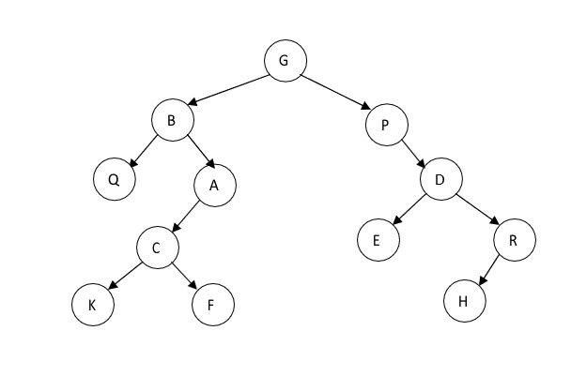
ANSWERS...

Slide 8
Construct a tree for the given Inorder and Postorder traversals
Input: Inorder and postorder travel of a binary tree
Output::::Binary tree
Algorithm:
Step 1: the last element in the postorder is the root.
Step 2: Locate the index of the root node in the inorder traversal. All the nodes before the root node in the inorder traversal forms the left subtree. All the nodes after the root node in the inorder traversal forms the right subtree.
Step 3: Now perform the steps 1 and 2 until the tree is constructed.

Slide 9
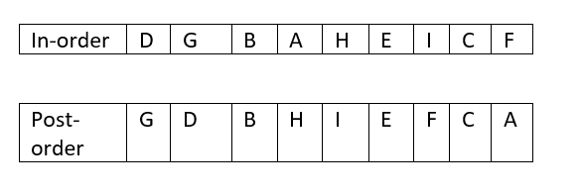
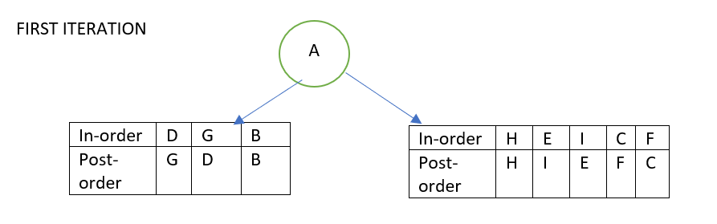
EXAMPLE

Slide 10
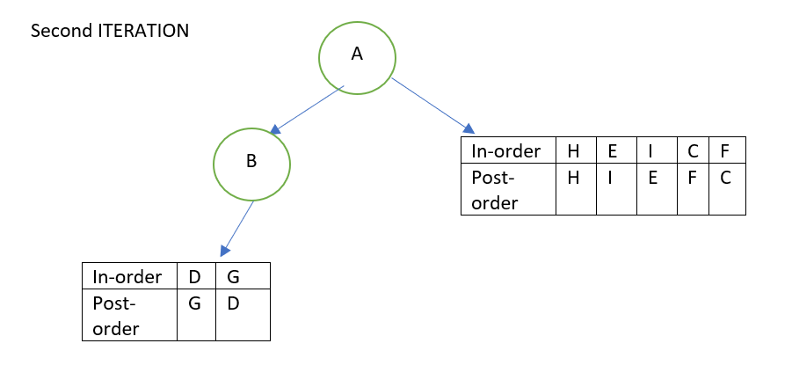

Slide 11
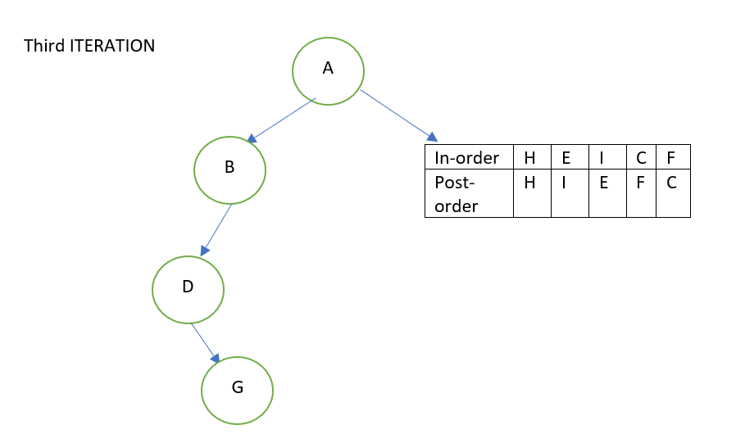

Slide 12
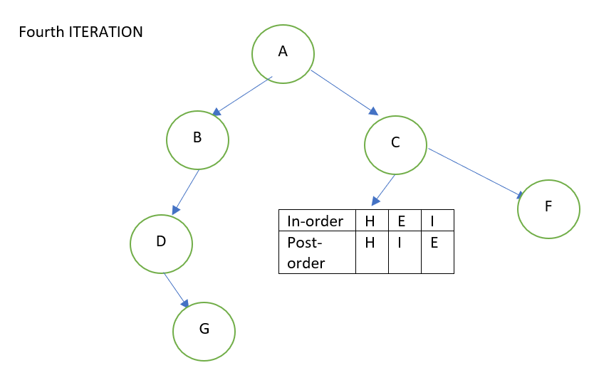

Slide 13
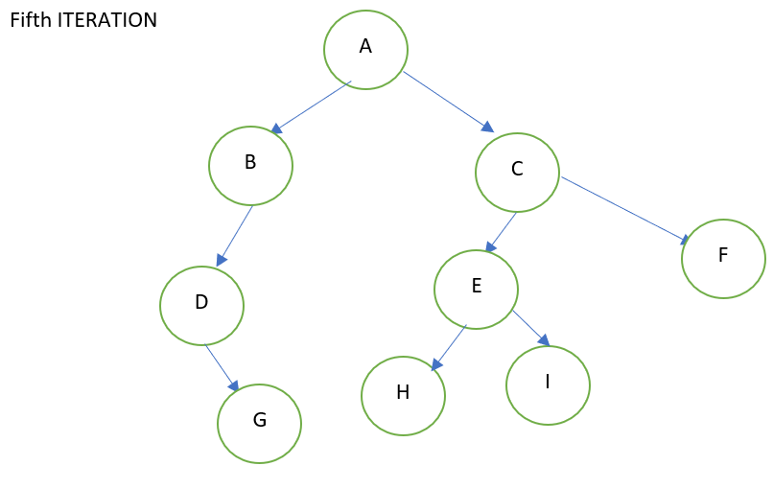

Slide 14
Try it yourself!!!!!!!!!!
Postorder : C B E H G I F D A
Inorder: B C A E D G H F I
Inorder: D G B A H E I C F
Postorder: G D B H I E F C A

Slide 15
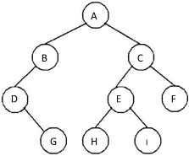
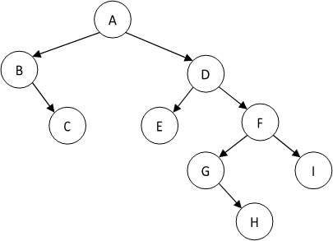
Answers!!

Slide 16
Construct a tree for the given Preorder and Postorder traversals
ALGORITHM:
Step 1 : the first element of pre-order or the last element of post-order is root of tree.
Step 2: Find n1--- predecessor of root node in postorder. locate n1 in pre order. All the elements from n1 to the end forms the RST
Step 3: Find n2--- Successor of root node in preorder. Locate n2 in post order. All the elements from the beginning to n2 forms LST.
Step 4: Repeat steps 1 to 3 till the tree is completed

Slide 17
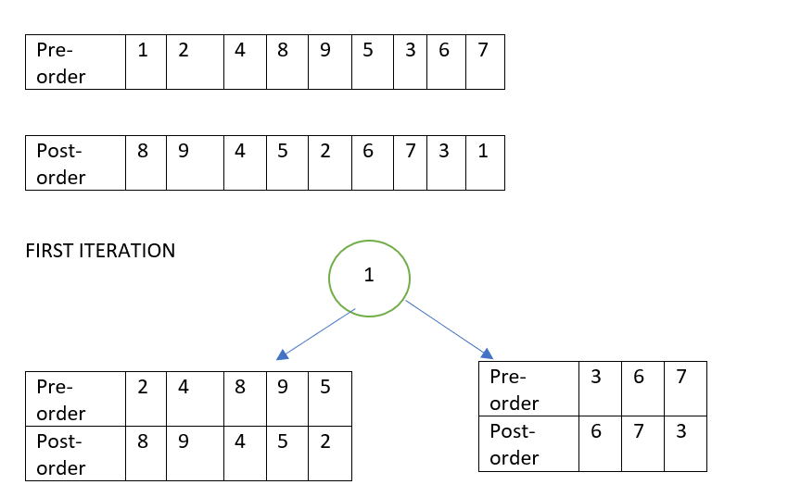
EXAMPLE

Slide 18
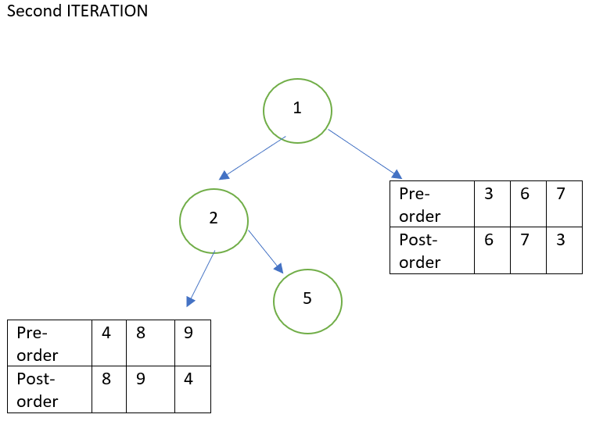

Slide 19
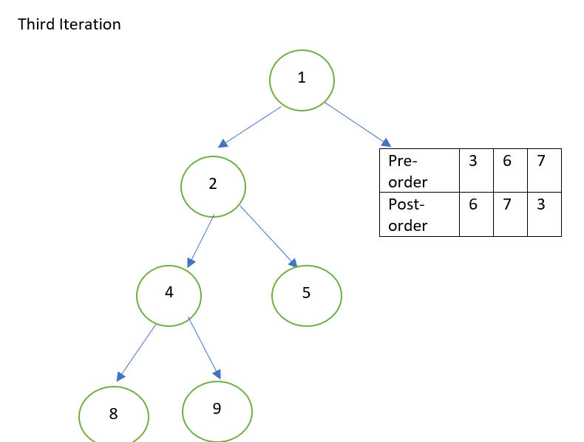

Slide 20
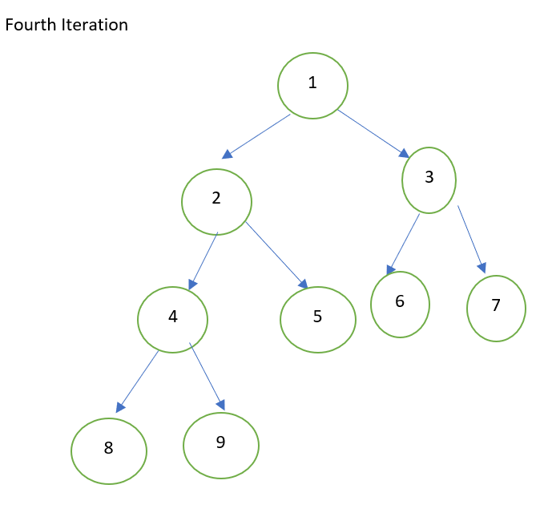

Slide 21
TRY IT YOURSELF!!!
PREORDER----A B D H I E C F G
POST ORDER----H I D E B F G C A

Slide 22
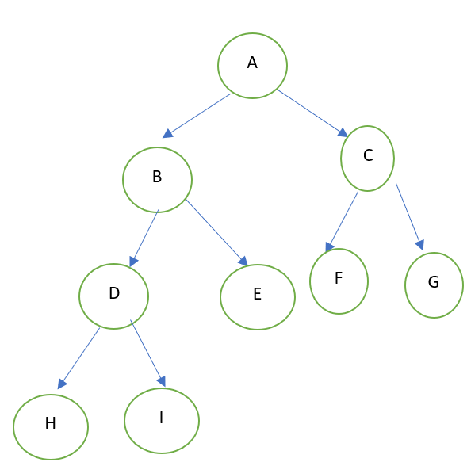
ANSWERS

